Slide 1
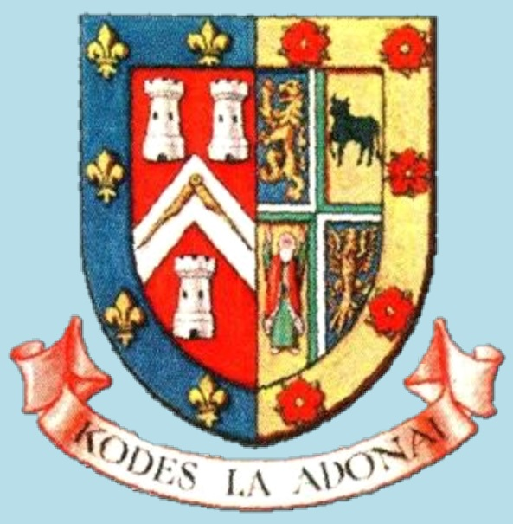
Talking Heads Province of West Lancashire
Holy Royal Arch - The Next Masonic Step
Reviewed 08/02/20
Notes:
PM: - Not at all, most are just acknowledged. That recognition is demonstrated by the fact that the head of Royal Arch in our Province is our own Provincial Grand Master James Anthony Harrison
Click to [SLIDE 2]

Slide 2
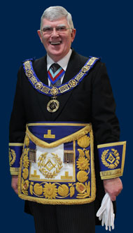
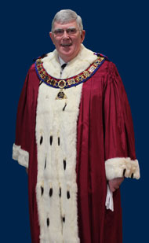
Holy Royal Arch - The Next Masonic Step
PROVINCIAL
GRAND MASTER
MOST EXCELLENT
GRAND SUPERINTENDENT
Notes:
PM: - It is called a Triple Tau and it is the symbol of Royal Arch in a similar way that the square and compasses are symbolic of craft masonry. [SLIDE 3] Click for each tau triangle circle and finish.

Slide 3
T
T
T
The Triple Tau

Slide 4
Talking Heads Province of West Lancashire
Holy Royal Arch - The Next Masonic Step

Slide 5
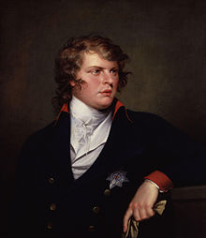
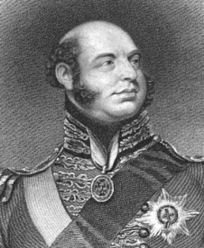
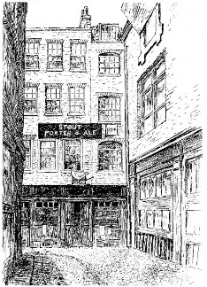
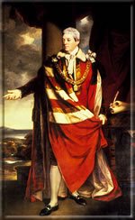
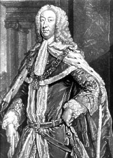
Holy Royal Arch The Next Masonic Step
1717
1751
1813
Premier
Grand Lodge
Antient
Grand Lodge
The Union of the two Grand Lodges
or
‘The Moderns’
or
Atholl Grand Lodge
RA Ceremonies worked separately
RA worked in Craft Lodges

Slide 6
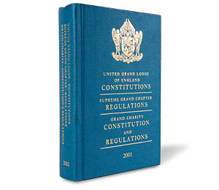
Holy Royal Arch - The Next Masonic Step
“By the solemn Act of Union between the two Grand Lodges of Free-Masons of England in December 1813, it was ‘declared and pronounced that pure Antient Masonry consists of three degrees and no more, viz., those of the Entered Apprentice, the Fellow Craft, and the Master Mason, including the Supreme Order of the Holy Royal Arch’.

Slide 7
Talking Heads Province of West Lancashire
Holy Royal Arch - The Next Masonic Step
Notes:
PM: - Not at all, most are just acknowledged. That recognition is demonstrated by the fact that the head of Royal Arch in our Province is our own Provincial Grand Master James Anthony Harrison
Click to [SLIDE 2]

Slide 8
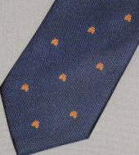
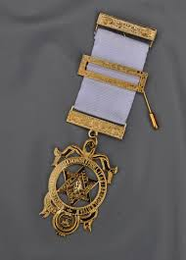
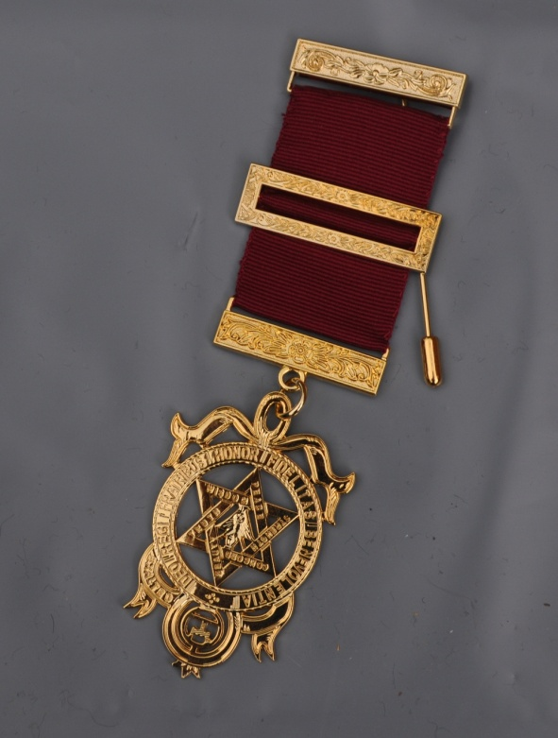
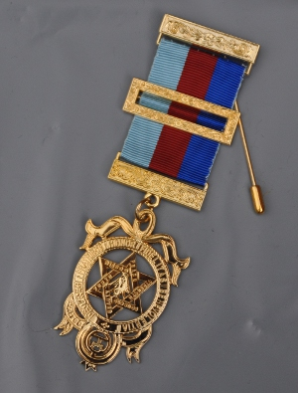
Holy Royal Arch - The Next Masonic Step

Slide 9
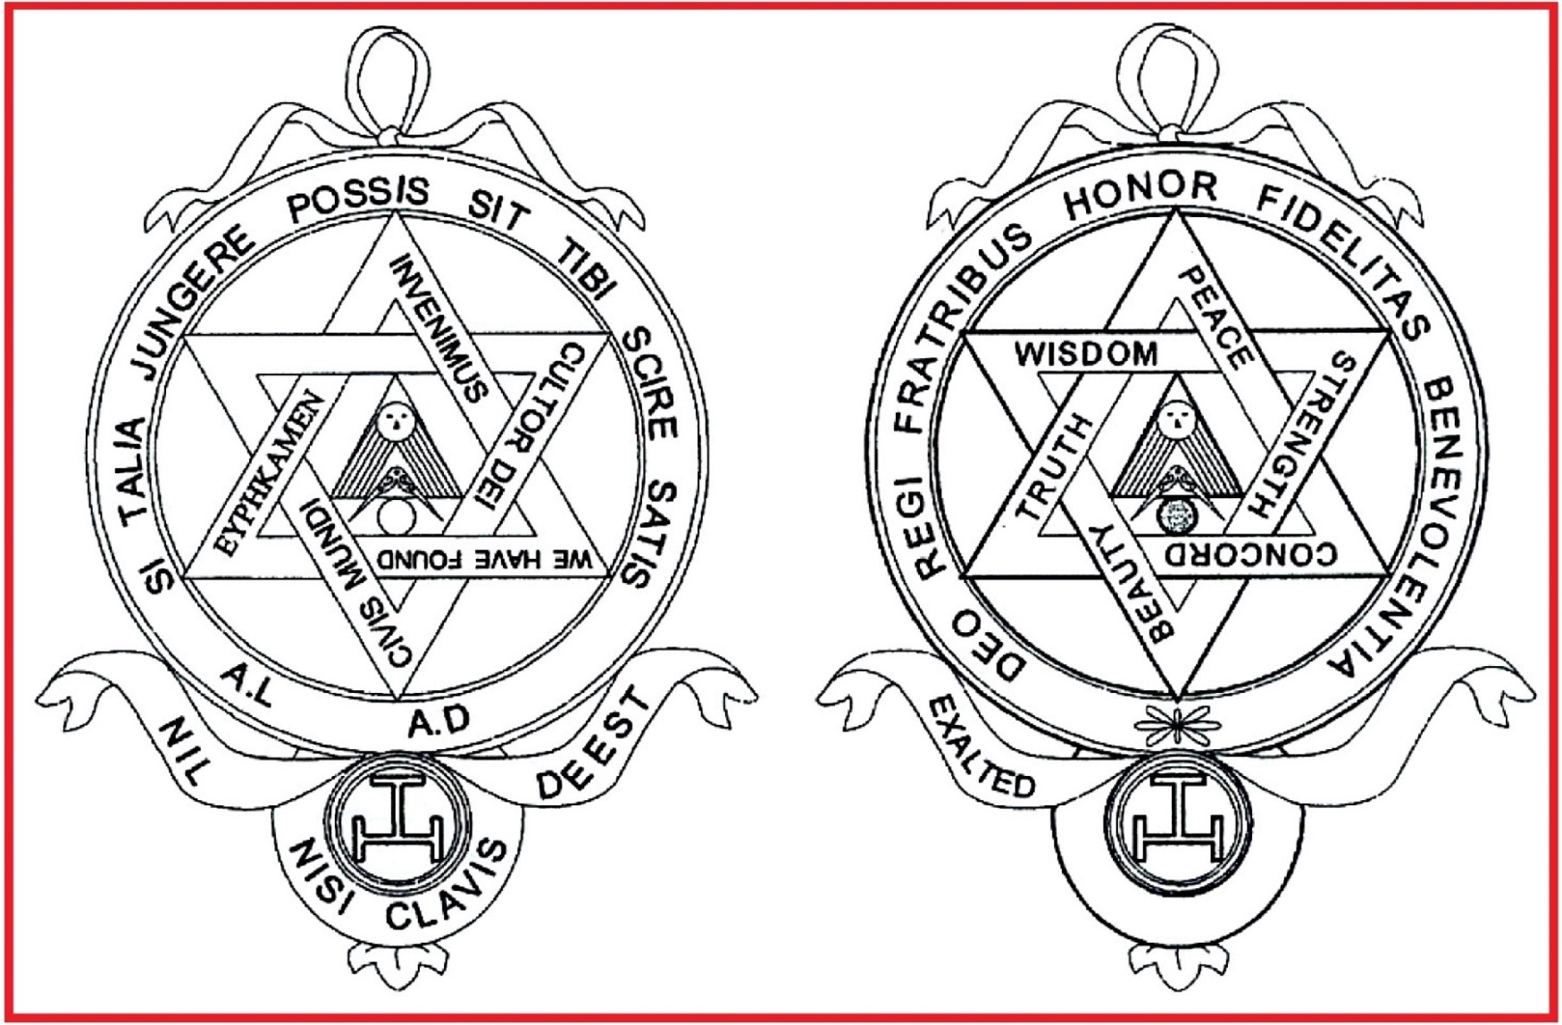
Holy Royal Arch - The Next Masonic Step

Slide 10
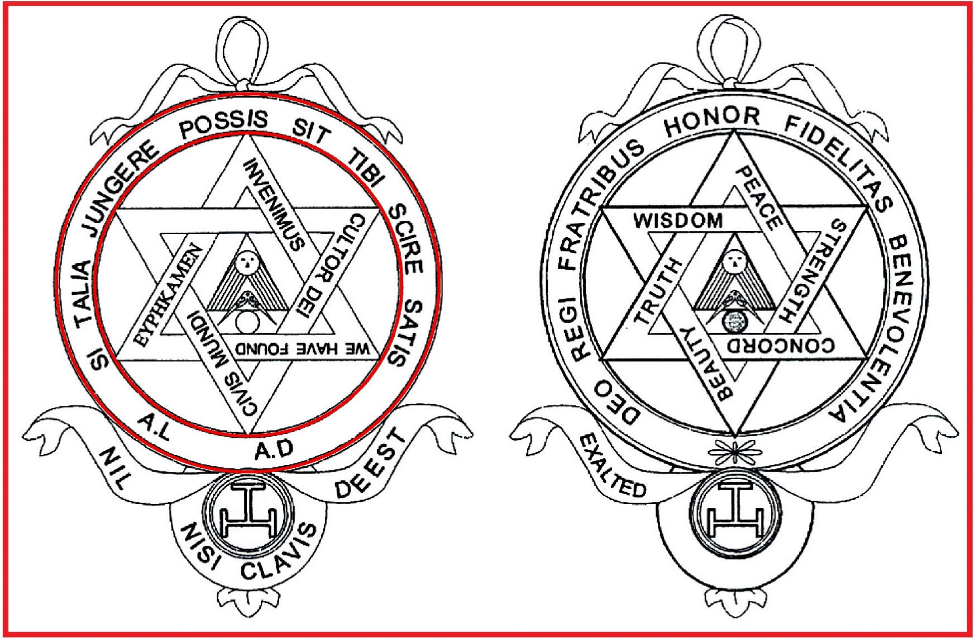
Holy Royal Arch - The Next Masonic Step

Slide 11
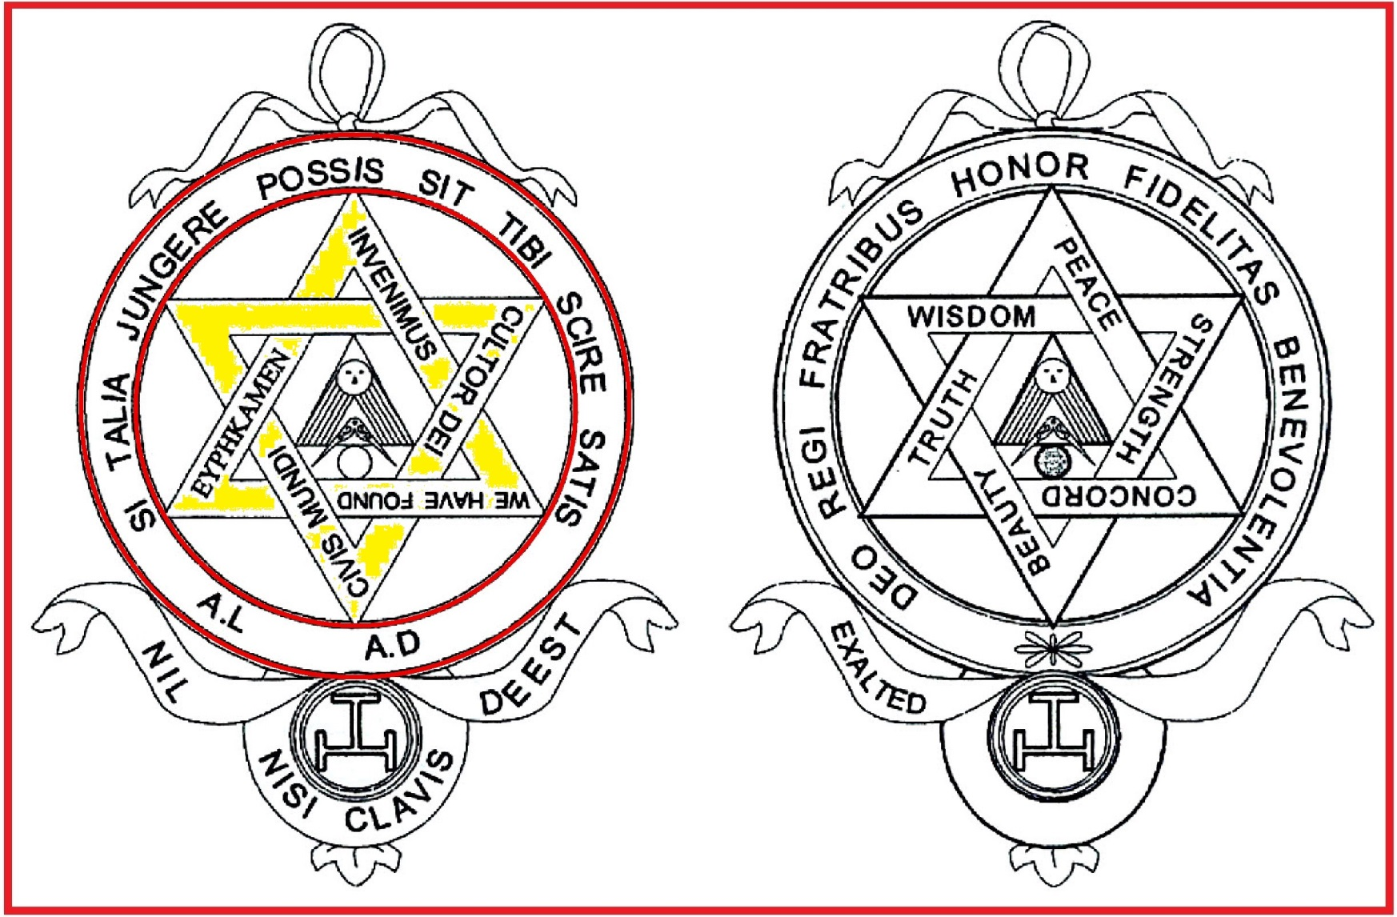
Holy Royal Arch - The Next Masonic Step
‘NIL NISI CLAVIS DEEST’ --- ‘NOTHING IS WANTING BUT THE KEY’

Slide 12
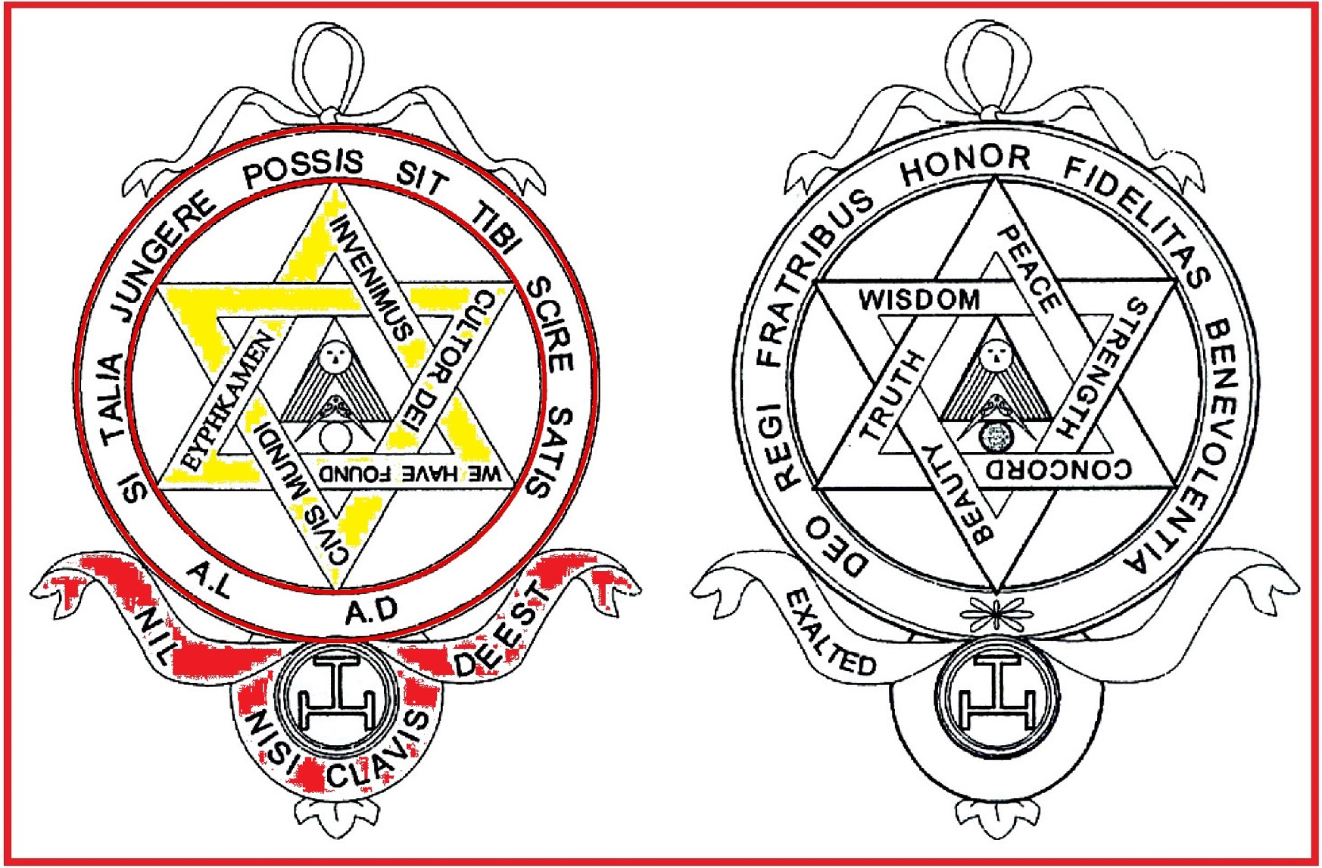
Holy Royal Arch - The Next Masonic Step
‘NIL NISI CLAVIS DEEST’ --- ‘NOTHING IS WANTING BUT THE KEY’

Slide 13
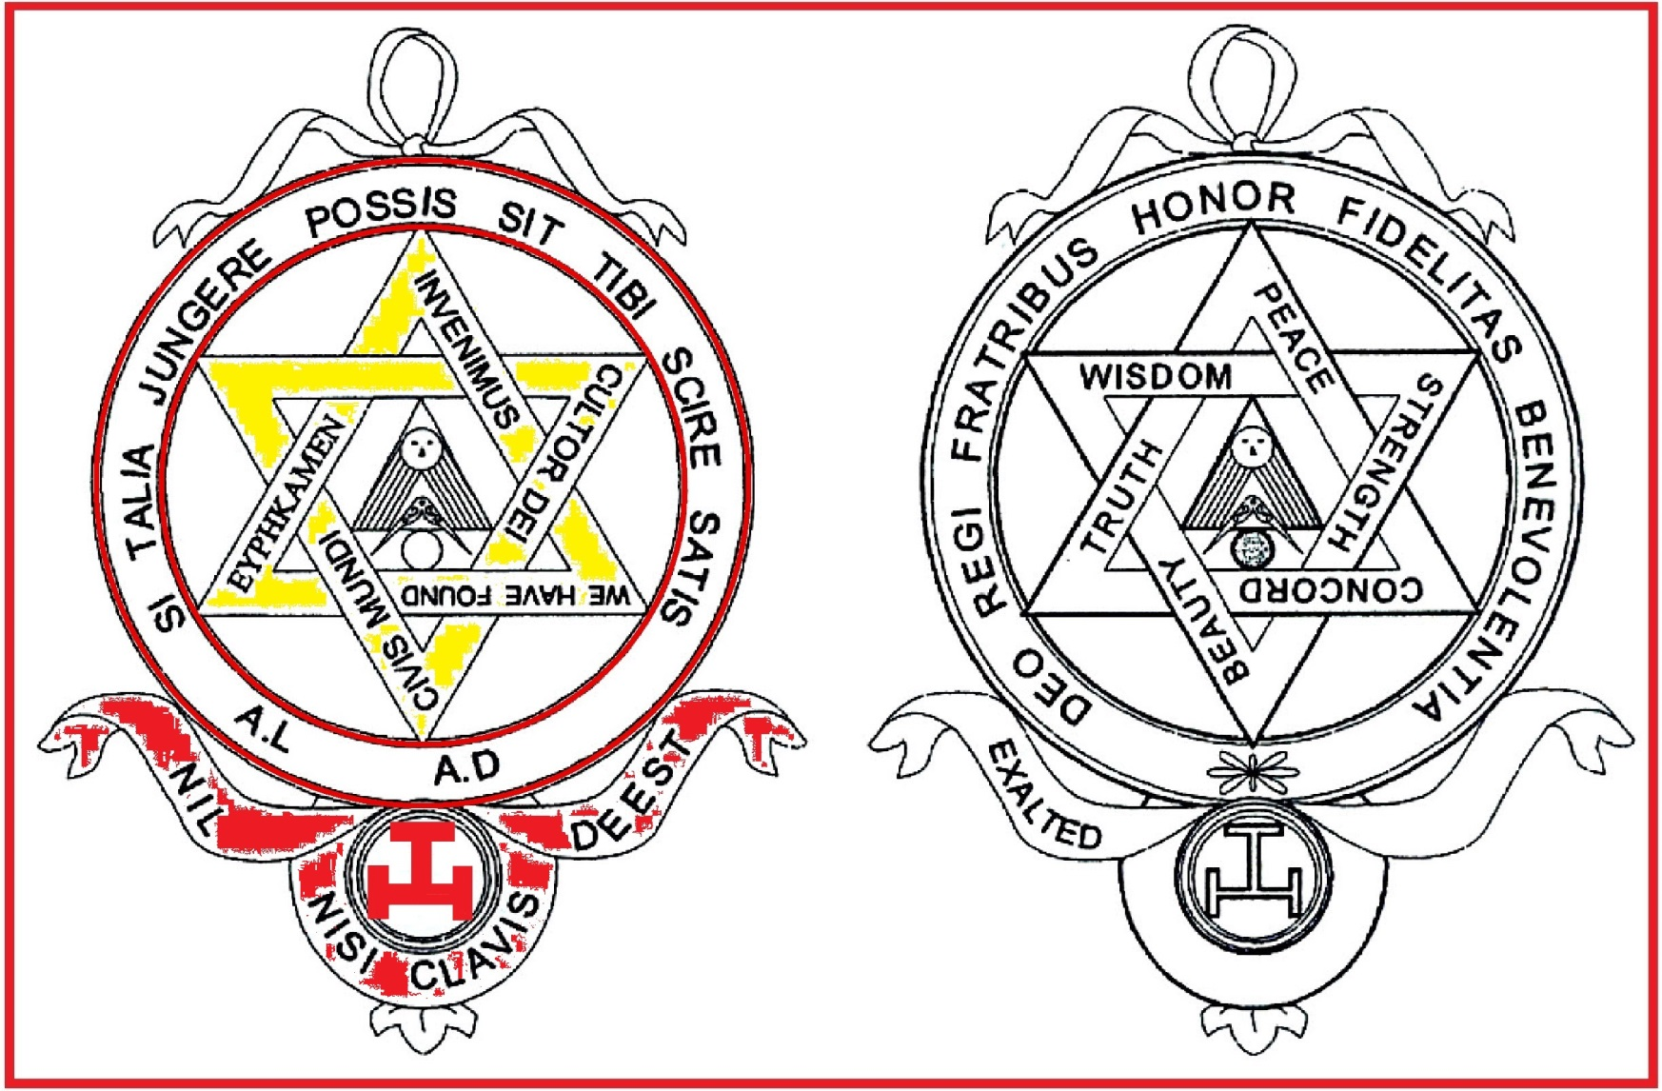
Holy Royal Arch - The Next Masonic Step
‘NIL NISI CLAVIS DEEST’ --- ‘NOTHING IS WANTING BUT THE KEY’

Slide 14
Talking Heads Province of West Lancashire
Holy Royal Arch - The Next Masonic Step

Slide 15
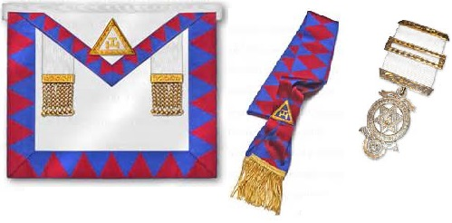
Holy Royal Arch - The Next Masonic Step

Slide 16
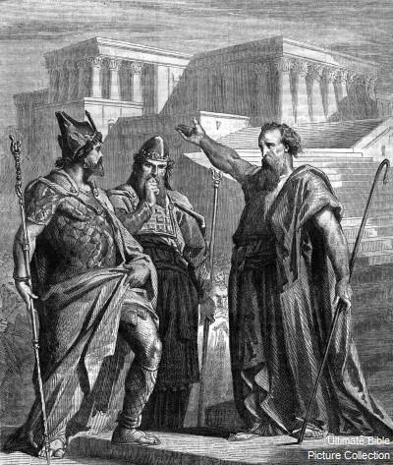
Holy Royal Arch - The Next Masonic Step
“WE WILL REBUILD THE TEMPLE TO THE HONOUR AND GLORY OF GOD”

Slide 17
Talking Heads Province of West Lancashire
Holy Royal Arch - The Next Masonic Step

Slide 18
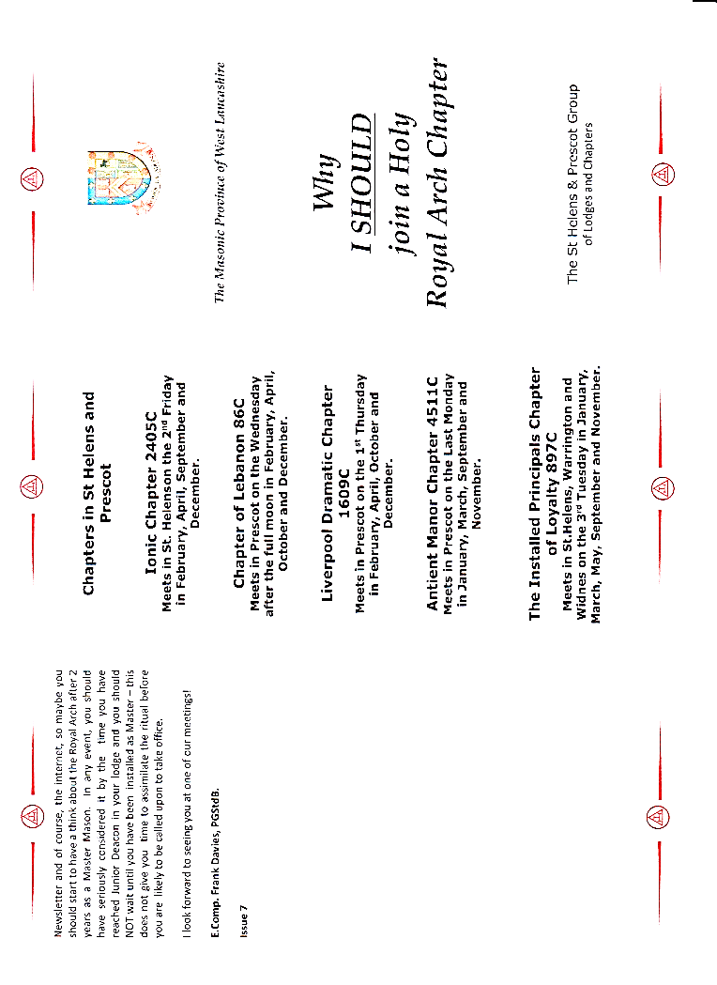
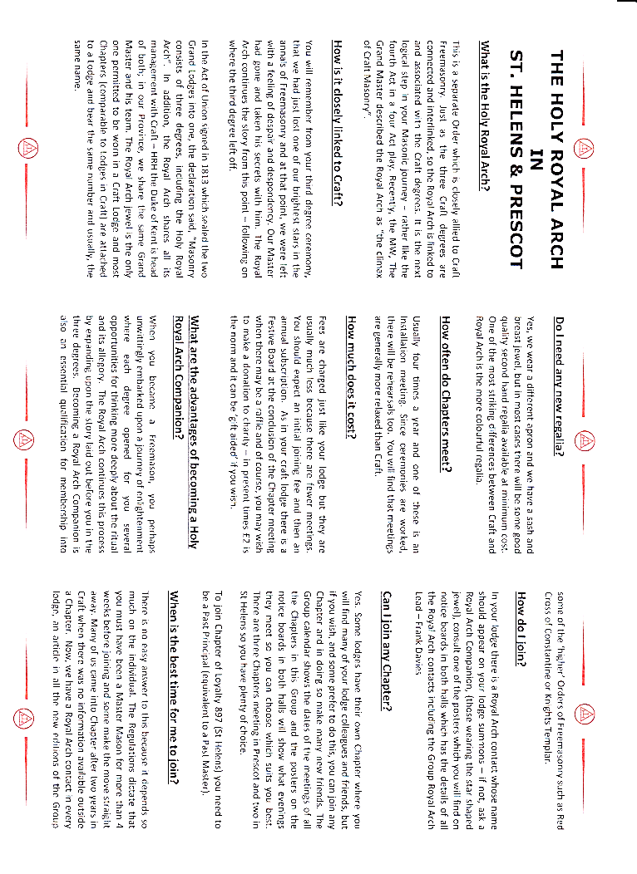
Holy Royal Arch - The Next Masonic Step

Slide 19
Province of West Lancashire
Holy Royal Arch - The Next Masonic Step
‘The Royal Arch is considered both the completion and the climax of pure Ancient Freemasonry.’

